Slide 1

Interfacing with Keyboard and Display
Nafis Mustakin
Lecturer, CSE-UIU

Slide 2
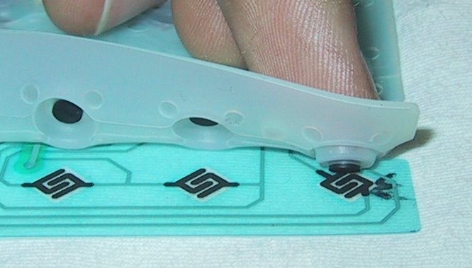

KEYBOARD
The Keyboard is the most common input device
When you press a key on a keyboard, you are activating a switch
To understand a keyboard, one must first understand the kinds of switches that are used.

Slide 3
Types of keyboard switches
Mechanical key-switches
Membrane key-switches
Capacitive key-switches
Hall effect key-switches:

Slide 4
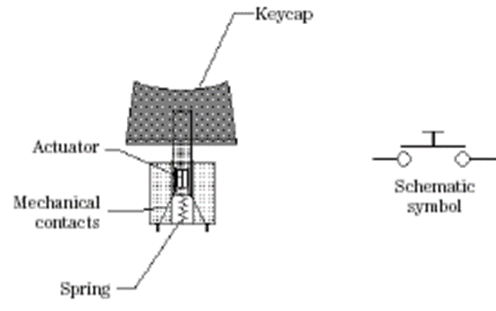
MECHANICAL key-switches
Two pieces of metals are pushed together when one presses the key.
Often made of a phosphor-bronze alloy with gold plating on contact areas.
Contain a spring to return the key to the non-pressed position
Also may contain a small piece of foam to help damp out bouncing

Slide 5
MECHANICAL key-switches
Mechanical switches are inexpensive but they suffer from contact bounce.
A pressed key may make & break contact several times before it makes solid contact.
contacts may become oxidized or dirty with age. Results in an improper contact.
They have a lifetime of 1 million keystrokes.

Slide 6
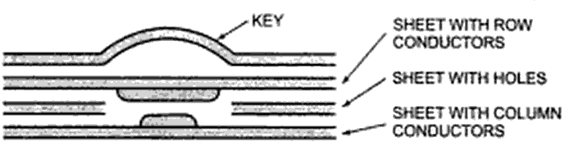
MEMBRANE key-switches
Special types of mechanical switches.
Consists of 3 layers of plastic or rubber sandwich.
The top layer has a conductive line of silver ink running under each row of keys.
The middle layer has a hole under each key position
The bottom layer has a conductive line of silver ink running under each column of keys
When we press a key we push the top ink line through the hole to contact the bottom ink line.
The advantage is that these types of key-switches can be made very thin and sealed units. Lifetime of these key-switches vary over a wide range.

Slide 7
Keyboard circuit connection & interfacing
The architecture of most of the keyboards looks like a matrix.
Key switches are connected in a matrix of columns & rows.
The rows of the matrix are connected to output port lines and the column lines of the matrix are connected to input port lines.
Getting meaningful data from a keyboard, requires three major tasks
Detect a keypress
Debounce the keypress
Encode the keypress (produce a standard code for the pressed key)
The three tasks can be done with
Hardware
Software
Combination of software and hardware

Slide 8
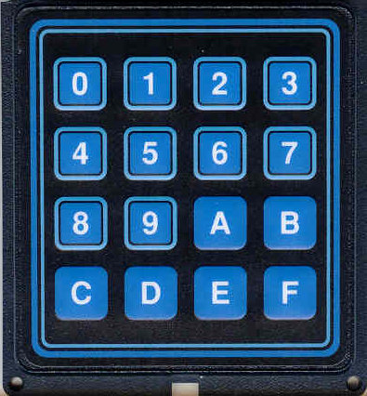
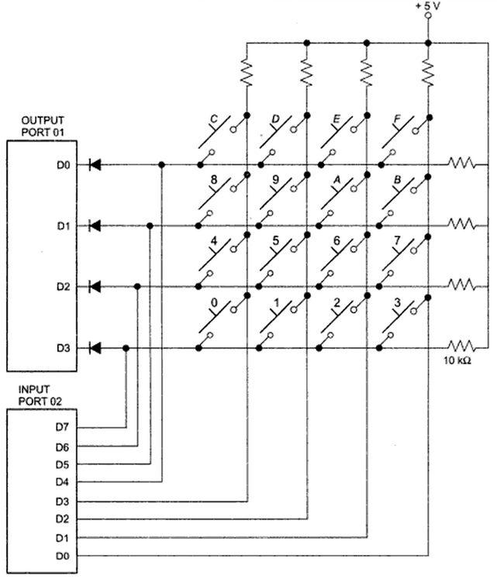
SOFTWARE KEYBOARD INTERFACING
A connection between a hexadecimal keypad and a microprocessor
The rows of the matrix are connected to four output port lines and the column lines of the matrix are connected to four input lines.
When no key is pressed, the column lines are held high by the pull-up resistors to +5v.
The main principle here is that pressing a key connects a row to a column.
If a low is output on a row and a key in that row is pressed, then the low will appear on the column, which contains that key and can be redetected at the input port.
If one knows the row and the column of the pressed key, one then knows which key is pressed.
Therefore, the keyboard controller has to do three steps for the detection of a key-press.
(1) Scan the rows
(2) Sense the columns
(3) detect the key-press

Slide 9
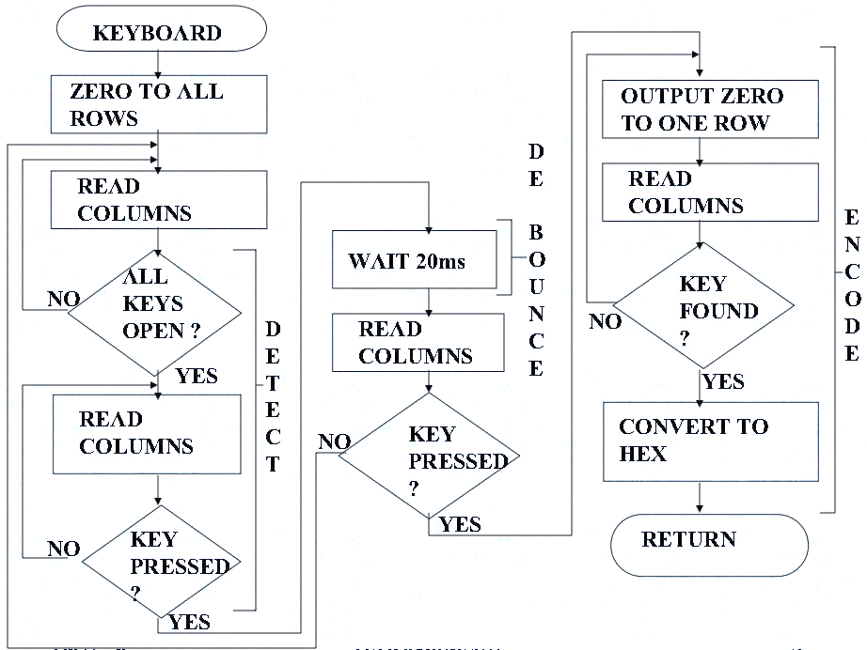
SOFTWARE KEYBOARD INTERFACING

Slide 10
Seven-Segment LEDs
Seven-segment LEDs
Often used to display BCD numbers (1 through 9) and a few alphabets
A group of eight LEDs physically mounted in the shape of the number eight plus a decimal point as shown in Figure 9-5 (a)
Each LED is called a segment and labeled as ‘a’ through ‘g’.

Slide 11
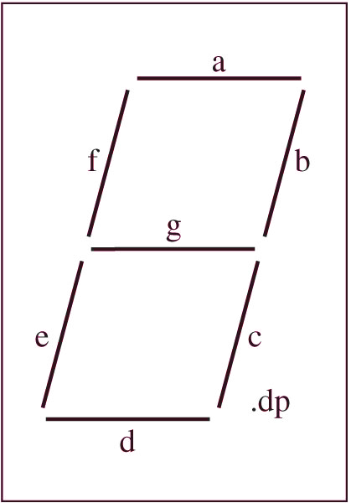
Seven-Segment LEDs
Two types of seven-segment LEDs
Common anode
Common cathode
decimal point

Slide 12
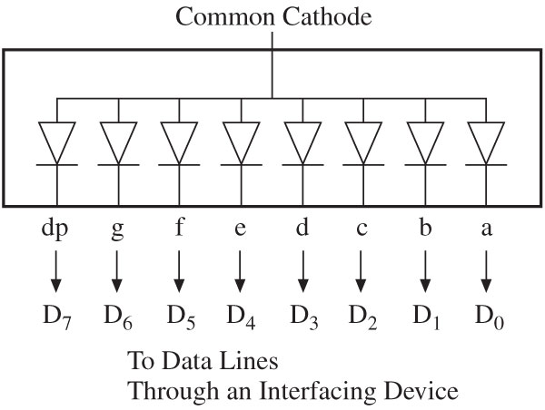
Common Anode Seven-Segment LEDs
Anode
In a common anode seven-segment LED
All anodes are connected together to a power supply and cathodes are connected to data lines
Logic 0 turns on a segment.
Example: To display digit 1, all segments except b and c should be off.
Byte 11111001 = F9H will display digit 1.

Slide 13
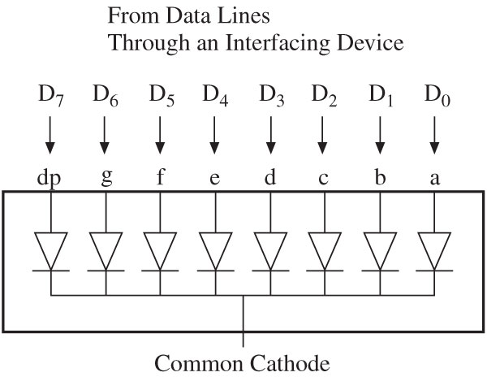
Common Cathode Seven-Segment LEDs
In a common cathode seven-segment LED
All cathodes are connected together to ground and the anodes are connected to data lines
Logic 1 turns on a segment.
Example: To display digit 1, all segments except b and c should be off.
Byte 00000110 = 06H will display digit 1.

Slide 14
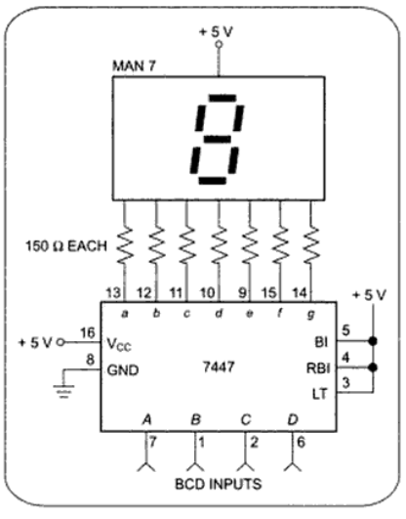
Directly Driving Seven-Segment LEDs

Slide 15
Directly Driving Seven-Segment LEDs
Advantages
Works well for driving just one or two LEDs
Disadvantages
Have several problems if we want to drive more digits
Assume we want to Display 8 Digits
For worst case calculation, assume all 8 digits are displaying digit 8
20 mA per segment gives a current of 140 mA per digit
Total 1.2A for 8 digits
Around 13mA per 7447
Around 104 mA for 8 7447
As a result, current required to drive the LEDs + decoders might be several times the current required by the rest of the circuitry

